Slide 1
L3GD20H – Gyroscope
Kenneth chen

Slide 2
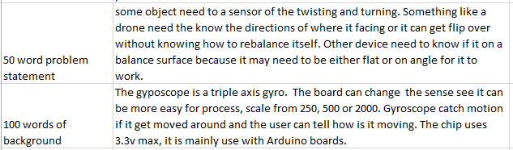
Introduction (Proposal)
Gyroscope is use to detect movement change in angle degrees
Original plan was to make a rc car/drone that know how to rebalance itself
Currently it is motion sensor for when the user moves the device around

Slide 3
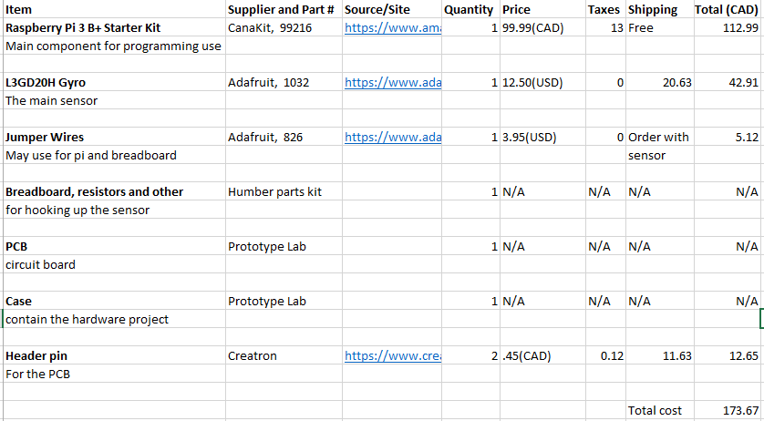
Budget
Updated the budget cost for adding the Header pin for PCB
The shipping cost is cheaper then what is say on the excel sheet because I split the with a person
There no cost PCB and Case
Already own a breadboard

Slide 4
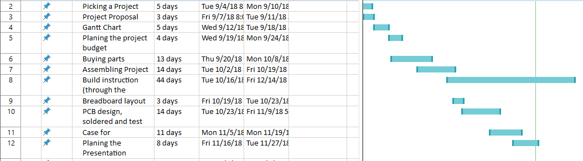
Schedule
Only showing Sept to Dec Gantt chart
My progress is very close with my Gantt chart since is very generalized now looking back at it

Slide 5
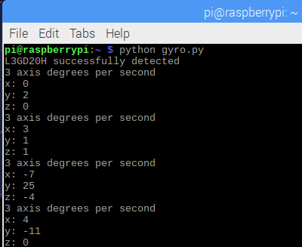
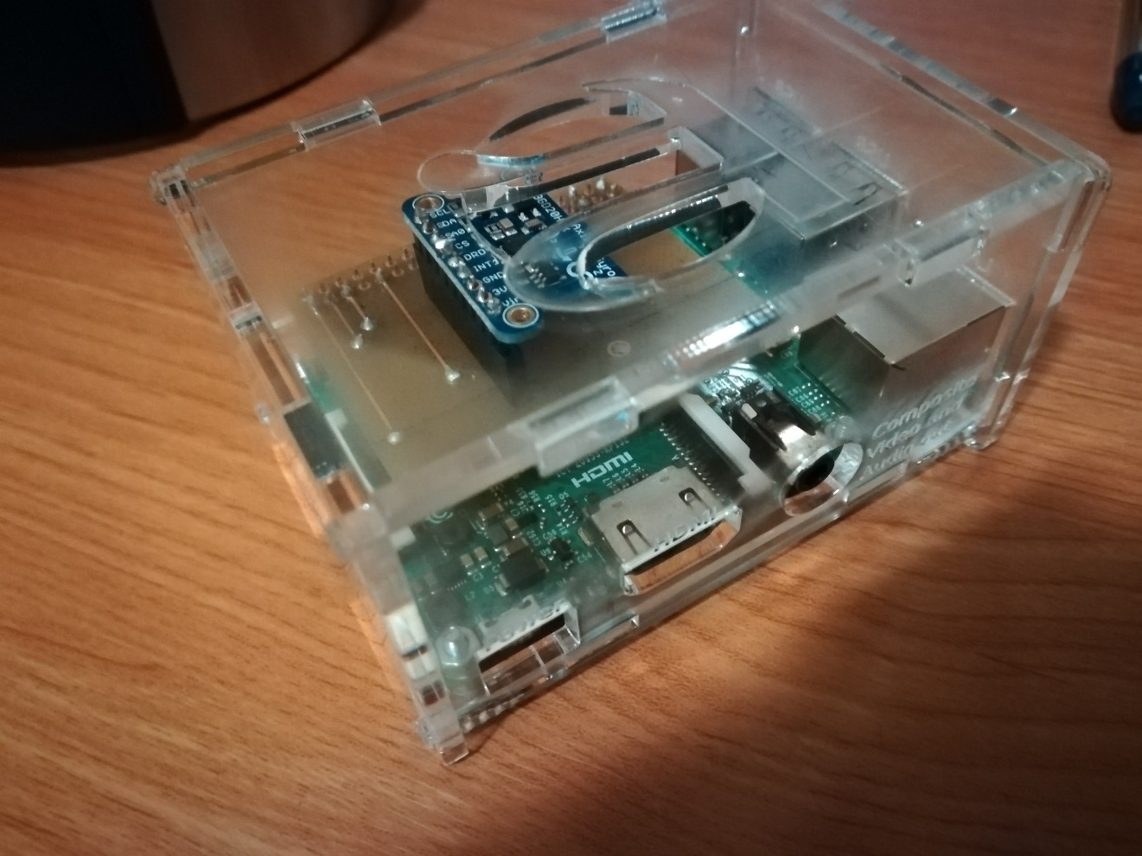
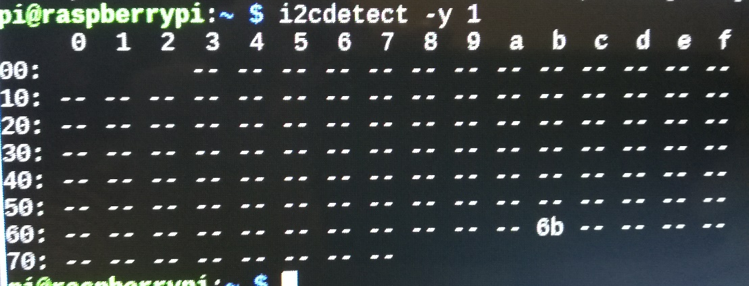
Images of gyroscope

Slide 6
Knowledge use from other courses
TECH 103 Digital Fundamentals & CENG 215 Digital and Interface Systems
Learn to hook up chips and read diagram
TECH 153 Technical C
First time using a raspberry pi
WRIT 220 Technical Workplace Wrt Skls
Help with my writing skill
CENG 252 Embedded Systems
Having circuit board commutating with computer

